Slide 1
Agenda
For this session, content from Dev Days 2016 will be used.

Slide 2
Abstract
A common misconception in LabVIEW is that using objects will make an application more complex, and harder to use and maintain. The reality is that many applications are over complicated because they try to avoid using objects.
In this session we will covering the basics of object oriented and how to deal with architectures and applications that use them. Please note, this session does not cover object oriented design. For more information, you can take NI’s Object Oriented Design and Programming in LabVIEW training course.

Slide 3
Distributed Control and Automation Framework (DCAF)
Demystifying LabVIEW Objects
Instructor Name
Instructor's role
Notes:
This content is taken from a session given at the Dev Days in 2016
People that contributed with this content:
Benjamin Celis
Mathew Pollock
Simon Perez
Andres Gomez

Slide 4
Agenda
OOP Concepts
Classes in LabVIEW
Libraries
Clusters
Why to use classes?
Inheritance
Dynamic dispatch
Demo: Working with LabVIEW Classes
Using Classes
Next steps
Notes:
The idea behind this presentation is allow new LabVIEW users to understand how LabVIEW objects work, based on the concepts they are already familiar. Once they realize that Objects are nice clusters inside of a library we will talk about the advantages of using them
There are many examples to explain Object Oriented. In this presentation we are going to use the Shape example having a square and a circle.
For the Advance demo we are using CEF. This is not cover in the application. And is just shown in how to override a method. The same demo can be done just with the classes, In the slides I am using the screenshots from the CEF. But can be replaced with the Shape. I attached the slides for shape at the end of the slides.

Slide 5
OOP Concepts

Slide 6
Object-Oriented Design (OOD)
Object-oriented design requires programmers to think of a program in terms of objects, instead of procedures.
An object is encapsulated data and the methods for accessing that data.
Object-Oriented Programming (OOP)
Development of code in a language that enforces OO design principles.
With some discipline, you can do OO design in any language.
OOP is done with programming languages that have syntax for describing classes and methods.
An OOP language helps guarantee that your code matches your design.

Slide 7
Object User Levels
LabVIEW Object Designer
Designs the top level application
Defines the abstract classes
Decides inheritance paths
LabVIEW Object User
Uses object oriented based architectures like Actor Framework or Configurator Editor Framework (CEF)
Creates child classes of abstract objects
Notes:
In general when working with LabVIEW object oriented we work with them at 2 different levels:
Object Oriented Designer
Object user.

Slide 8
Object User Levels
LabVIEW Object Designer
Designs the top level application
Defines the abstract classes
Decides inheritance paths
LabVIEW Object User
Uses object oriented based architectures like Actor Framework or Configurator Editor Framework (CEF)
Creates child classes of abstract objects
Notes:
In general when working with LabVIEW object oriented we work with them at 2 different levels:
Object Oriented Designer
Object user.
The purpose of this presentation is to help LabVIEW objects users to get familiar with objects and rip the benefits of working with them . In this slide is intentional the use of terms they will hear when talking about when talking about objects but they might be not familiar. During the presentation they will realize that in many cases they just know it with a different name.

Slide 9
What is a Class?
Class — A collection of data and the methods that interact with that data.
Classes are actors or things acted upon.
Classes are NOUNS.
Classes are data types.
What is an Object?
A specific instance of a class.
Refers to individual pieces of data.
A class can have many objects (instances).

Slide 10
What is a Method?
Method — An action that can be performed using the data of a class.
Methods are performed by objects.
Methods are VERBS.
Methods are VIs.
Use or modify the data in an object.

Slide 11
Class as a Data Type
Class
Data
Methods
Data
Methods
+ =

Slide 12
Classes in LabVIEW

Slide 13
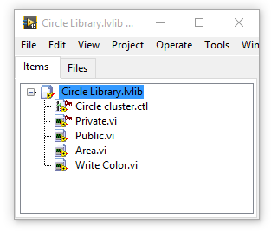
Libraries
A collection of related VIs, type definitions, shared variables, palette menu files, and other files
Organize related files into a shared hierarchy
Limit public access to certain files
Avoid potential VI name duplications
2 way link
Notes:
Public—Any VI can call the member VI as a sub VI.
Community—Only VIs within the same library, friends of the library, or VIs within a friend library can call the member VI. Community member VIs display a dark blue key glyph in the Project Explorer window. Refer to the Object-Oriented Design and Programming in LabVIEW course for more information about this scope.
Private—Only VIs within the same library can call the member VI. Private member VIs display a red key glyph in the Project Explorer window.
2 way link, the library knows what files belong to the library and the files know to which library they belong. Only LabVIEW files (controls, Vis and libraries) can be inside of a library
Name Space: A VI is loaded into LabVIEW memory using the Library name as part of its name. For example VI save in library File, would be read as File:Save. This allows me to also have a si called Save in a Configuration library because it will appear as Configuration:Save.
You still cant have both files in the same folder. You should always create a folder for each class.

Slide 14
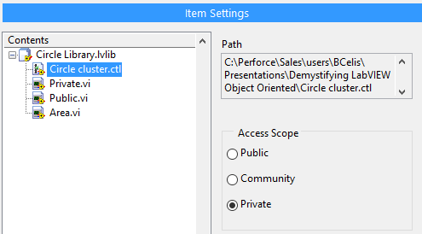
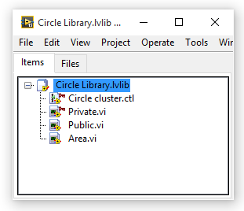
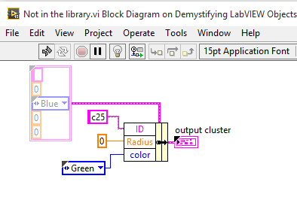
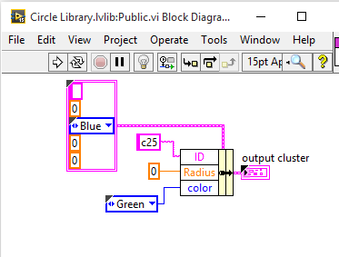
Access Scope
Notes:
Public—Any VI can call the member VI as a sub VI.
Community—Only VIs within the same library, friends of the library, or VIs within a friend library can call the member VI. Community member VIs display a dark blue key glyph in the Project Explorer window. Refer to the Object-Oriented Design and Programming in LabVIEW course for more information about this scope.
Private—Only VIs within the same library can call the member VI. Private member VIs display a red key glyph in the Project Explorer window.
2 way link, the library knows what files belong to the library and the files know to which library they belong
Talk about the benefit of Data Encapsulation.

Slide 15
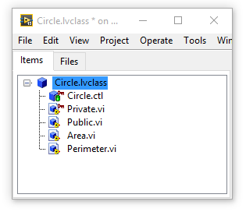
LV Class
A collection of related VIs, type definitions and other files
Organize related files into a shared hierarchy
Avoid potential VI name duplications
Limit public access to certain files
2 way link
Inheritance and dynamic dispatch
Must have class private data
Property nodes
Notes:
The same as with the Class Private Data slide. It is almost the same expect for the Dynamic Dispatch. WE are going to talk about that in the second part of the presentation.
Property nodes are methods that can be accessed using the

Slide 16
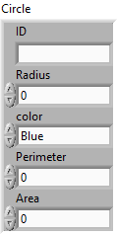
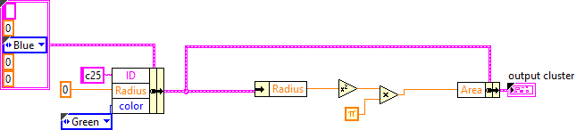
Cluster
It’s a data structure
Clusters group data elements of mixed types
Bundle and unbundle
Pink, brown or beer yellow
Notes:
Clusters are basic data structures in LabVIEW
They allow us to bundle multiple wires and values in a single LabVIEW wire simplifying our block diagram and organizing data in a logical way.
Whenever we create a cluster is a good practice to make it a Type def.
Most clusters on the block diagram have a pink wire and data type terminal.
Clusters of numeric values, sometimes referred to as points, have a brown wire and data type terminal.
You can wire brown numeric clusters to Numeric functions to perform the same operation simultaneously on all elements of the cluster.
Error wire is a cluster.

Slide 17
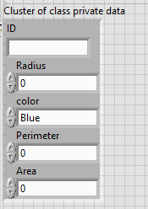
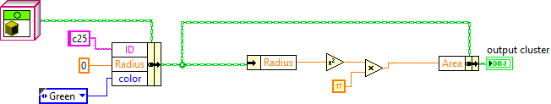
Class Private Data
It’s a data structure
Clusters group data elements of mixed types
Bundle and unbundle
You can choose the color you want
It defines the class properties
It is private
Notes:
The private Data of a class is just a cluster, that behaves like a cluster but is private to the class library. This means it can only be bundle and unbundled by Vis that belong to the class. That will be explain with the libraries.
The Private class data define the properties of a Class.

Slide 18
Methods: Color and Area
Notes:
Initialize method

Slide 19
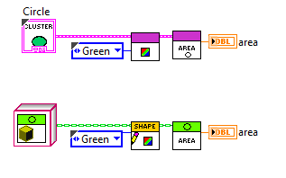
Methods: Color and Area
Notes:
Again the comparison between our class implementation is identical between the cluster and the Object. As long as I only have Circles. But the Square makes everything more complicated. How can I calculate the area of the Square and the circle.
The sub VIs that belong to a class are named Methods.
We are using Vis (Methods) to change the values in the cluster (properties)

Slide 20
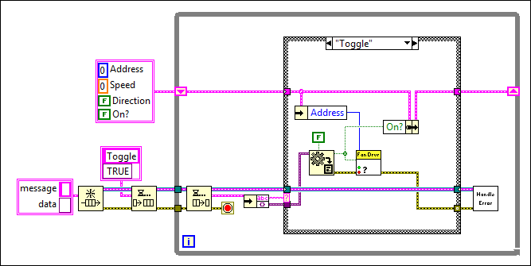
Cluster and Node...
Notes:
This is a data handler. This app is not using objects it just has a cluster and some sub VI. This is to compare the code between the 2 applications in a more complex application.

Slide 21
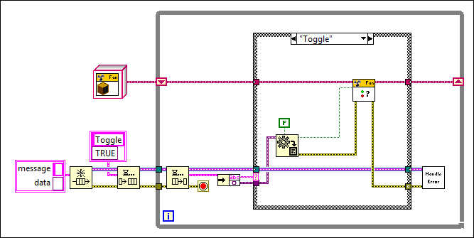
… become Class and Method
Notes:
This screenshot is from Actor Framework. It wont be covered in this presentation but its good to know what it is.
Still the idea here is that a code with or without classes looks similar. Except it looks cleaner with classes and we can expand it latter.

Slide 22
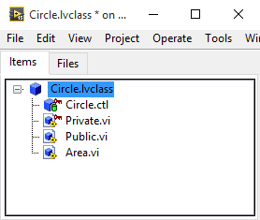
Cluster vs Class
Library
Cluster
VIs
LV Class
Private Data
Methods
=
=
=
Notes:
Class as a Data Type
A class is a collection of data bundled together with the set of methods (or functions) which interact with that data.
An class treats these two components as an inseparable whole (a concept known as encapsulation). When you pass an class around, you are passing both data and a way to use the data.

Slide 23
Why to Use Classes?

Slide 24
Scenario
Consider an application where we want to process and manipulate different shapes.
Shapes to process can be selected by the user or come from a file.
We want to be able to set different properties like color and dimensions.
We want to be able to perform calculations like area and perimeter.
New shapes, properties and calculations may be added in the future.
How do I store the information related to each of my possible shapes?

Slide 25
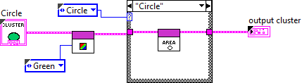
Possible Cluster implementation
Use a cluster to store the information of our shape.
What if properties are different? Ex: radio vs side.
Should I modify the cluster or make 2 different clusters?
How do I know if the shape is a circle or a square.
Add a enum?
How can I process several shapes in one array?
How easily can I add a new type of shape later?
Can I reuse code that is similar for the different shapes?
Notes:
Adding a new shape brings new problems:
Should I use a second cluster? If we go with 2 clusters that means that I need 2 different Vis for Set color as they have a different cluster for input.
With the internal data Either make a generic cluster hard to use. Or have to use different arrays one for Squares.
You can NOT make arrays of different clusters.
If I add triangle. I have to modify the top level VI affecting the case
Note: Point that is always important to make Enums Type definitions

Slide 26
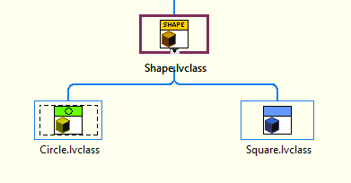
Solution: Use Classes

Slide 27
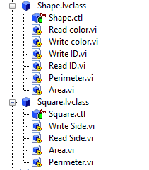
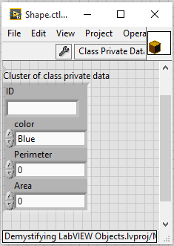
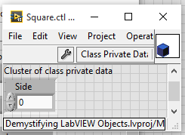
Inheritance
Common information Is stored in the parent
Can extend functionality without affecting the parent
Allows code reuse
Notes:
We can create a top level class called shape.
This class contains all the properties common to all classes. As well as its methods. You can point to Read ID and Write ID
The child class just need to implements the specifics

Slide 28
Dynamic Dispatch
Inherited methods can be overridden by child classes
Can build arrays with different shapes.
Which method to call for each instance is decided at runtime
Notes:
We can create a top level class called shape.
This class contains all the properties common to all classes. As well as its methods. You can point to Read ID and Write ID
The child class just need to implements the specifics

Slide 29
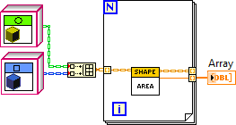
Adding the Square with Objects
Code is easier to read
Code is easier to maintain
Notes:
Note how the wire changes to orange at the bundle array. That is because it is changing to the parent class.
Dynamic dispatch selects which area I am calling. I don’t need additional identifiers, or case structures. Also I don’t need to modify the code inside the for loop to add additional shapes.

Slide 30
Disadvantages
More VIs
But Smaller and more modular
Have to be careful to include children classes when deploying code
But you have dynamic dispatch
Dynamic dispatch overhead
Cleaner code
Easier to debug
Notes:
In general most of the programs using LVOOP will have more VIs
Not everything is nice with objects. As with any architecture decision using objects has some drawbacks.
There are more Vis but Vis are smaller and more modular.
Even if you only have 1 class, the overhead of calling the methods is a larger than just using a cluster, as it needs to make identify the right class, even if there is one. This overhead is small considering the advantages OOP provides, still you should be careful not to overuse objects. If we have 2 Methods Add, and substract, and we have 100 elements, its better to have a dynamic dispatch method that works with an array inside, than calling 100 times method that only does one operation.

Slide 31
Working with LabVIEW OPP Architectures
DEMO
Notes:
Now that we know the basics, and understand that an object is cluster with a library and Dynamic dispatch allows us to call methods specific to the child we can talk about working with an architecture built with objects
As we mentioned before the idea of this presentation is helping the developers that have to face
Script is at the end of the slides. The 2 options for the demo is using the CEF example (Recommended) or just adding the triangle. The script is as slides, so if you are not comfortable showing it in LabVIEW you can present with the slides. Still It is simple enough that I Recommend a live demo.
The Architect already defined the classes
The Top Level VIs exist.
We need to extend and work with the Architecture provided.
The basic procedure is Create a new class
Inherit from parent
Customize the class: add properties and methods
Add class to main application

Slide 32
Demo Summary
Create new child from the parent class
Each class should be saved in its own folder
Override methods
Add your new class to the program
Notes:
To create a new child, create a new class file and change inheritance to point to the parent class.
Name space with the libraries, work inside of LabVIEW but not at the OS level, you cant have 2 Vis from different classes with the same name
You must override all the methods marked as Required, and the ones that have different behavior on the specific class.
How you add the class to the program will vary depending on the main VI architecture. In some cases you just need to add the children on a folder, and the main program will load into memory any plug in in there. In some cases you need to add the class constant in the initialization VI of the application, or in some cases you need to modify the part of the code that will call the class. In the CEF example we need to modify the Group>>Edit Options Vis to include he new channel.

Slide 33
Using Classes

Slide 34
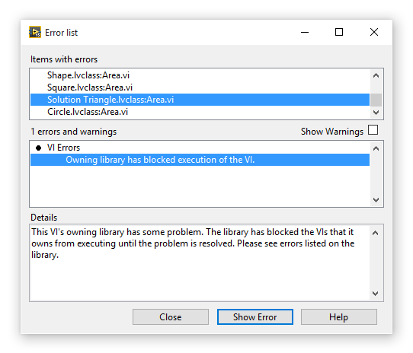
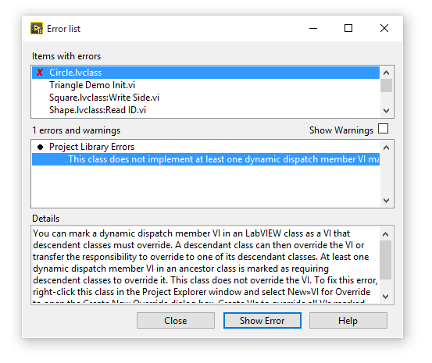
Errors in Classes
Notes:
One of the Most common problems with classes is that it has a broken run arrow, even if everything is fine in the VI. This overwhelms new class users and confuses them.
This happens because the parent class knows one method of one child is broken and is preventing you run by dynamic dispatch that vi.
To fix it search the vis with the X which are the ones with the actual error.

Slide 35
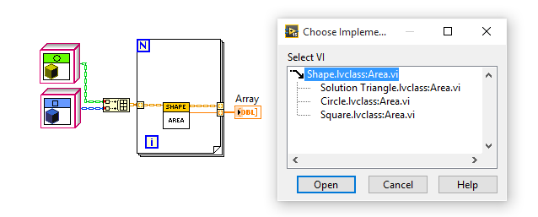
Selecting the Specific Implementation
Notes:
In this example when I double Click on the area VI it wont open a block diagram directly
It will give me a list of possible implementations. In here I can select which of this implementations I want to see.
If a method is in gray that means that child class has no implementation of it and is using the parent method.

Slide 36

More Specific and Less Specific
Up casting allows the class to get to a parent class, with this you can get access to its methods and property nodes
If a property or method are specific to a child you need to down convert to it.
Notes:
You can notice how the wire changes between orange and blue

Slide 37
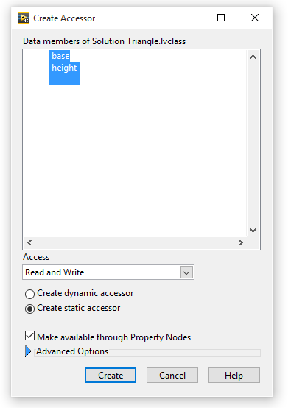

Property Nodes
Property nodes can be created to access the private Data of an object.
Notes:
When we create Accesor, Labview creates methods to acces the properties in the private data. LabVIEW also allows us to represent them as property nodes.

Slide 38
Conclusions and Next Steps
Notes:
Now that we know the basics, and understand that an object is cluster with a library and Dynamic dispatch allows us to call methods specific to the child we can talk about working with an architecture built with objects
As we mentioned before the idea of this presentation is helping the developers that have to face
Script is at the end of the slides. The 2 options for the demo is using the CEF example (Recommended) or just adding the triangle. The script is as slides, so if you are not comfortable showing it in LabVIEW you can present with the slides. Still It is simple enough that I Recommend a live demo.
The Architect already defined the classes
The Top Level VIs exist.
We need to extend and work with the Architecture provided.
The basic procedure is Create a new class
Inherit from parent
Customize the class: add properties and methods
Add class to main application

Slide 39
Conclusions
LabVIEW objects could be considered a private clusters inside of a library, with VIs that can be called dynamically using dynamic dispatch
Using objects can make code easier to maintain and extend
Avoiding objects can increase the complexity of your code

Slide 40
Next Steps
Object-Oriented Design and Programming in LabVIEW
NI Reference Designs ni.com/reference designs
LabVIEW Object-Oriented Programming: The Decisions Behind the Design www.ni.com/white-paper/3574/en/
Configuration Editor Framework (CEF) www.ni.com/example/51881/en/
Notes:
Object-Oriented Design and Programming in LabVIEW is a Custed Class that goes into more detail for Using Object Oriented.
Regardless of the implementation example CEF is an example of a Object Oriented Framework you can point people .

Slide 41
Quiz
Notes:
Now that we know the basics, and understand that an object is cluster with a library and Dynamic dispatch allows us to call methods specific to the child we can talk about working with an architecture built with objects
As we mentioned before the idea of this presentation is helping the developers that have to face
Script is at the end of the slides. The 2 options for the demo is using the CEF example (Recommended) or just adding the triangle. The script is as slides, so if you are not comfortable showing it in LabVIEW you can present with the slides. Still It is simple enough that I Recommend a live demo.
The Architect already defined the classes
The Top Level VIs exist.
We need to extend and work with the Architecture provided.
The basic procedure is Create a new class
Inherit from parent
Customize the class: add properties and methods
Add class to main application

Slide 42
Which of the next are properties of LabVIEW classes?
A collection of related VIs, type definitions and other files
Must have a class private data cluster
Access to internal files can be protected
Must have at least one child
If the class location in disk changes, VI members don’t need to be reconfigured to point to the new location as long as the class can find its members.
Notes:
A, B,C

Slide 43
Which of the next are properties of LabVIEW classes?
A collection of related VIs, type definitions and other files
Must have a class private data cluster
Access to internal files can be protected
Must have at least one child
If the class location in disk changes, VI members don’t need to be reconfigured to point to the new location as long as the class can find its members.
Notes:
A, B,C and E

Slide 44
Any VI inside or outside a class can bundle and unbundle the object contents as with any other cluster
True
False
Notes:
B. Class data is private and can only be accessed by internal methods.

Slide 45
Any VI inside or outside a class can bundle and unbundle the object contents as with any other cluster
True
False
Notes:
B. Class data is private and can only be accessed by internal methods.

Slide 46
What concept is best related to the next statements?
Inherited methods can be overridden by child classes
Which method to call for each instance is decided at runtime
Inheritance
Encapsulation
Dynamic Dispatch
Class Private Data
Notes:
C

Slide 47
What concept is best related to the next statements?
Inherited methods can be overridden by child classes
Which method to call for each instance is decided at runtime
Inheritance
Encapsulation
Dynamic Dispatch
Class Private Data
Notes:
C

Slide 48
Demo: Adding Triangle

Slide 49
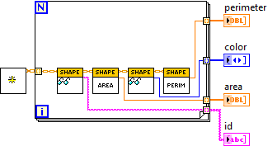
Top Level Application
The top level doesn’t need any changes just the Init to include the triangle
This is an advantage when creating top level VI with Objects
This VI uses dynamic dispatch to get the properties of all the shapes

Slide 50

Creating a new Class
To Create a new class Right click on the My computer
New >> Class
This will generate a new class. Save it to disk to a new folder
Notes:
Its really important to use a new folder every time we generate a class.
Name spacing inside LabVIEW is handle by the library but at windows level, there can’t be 2 files with the same name in the same directory.

Slide 51
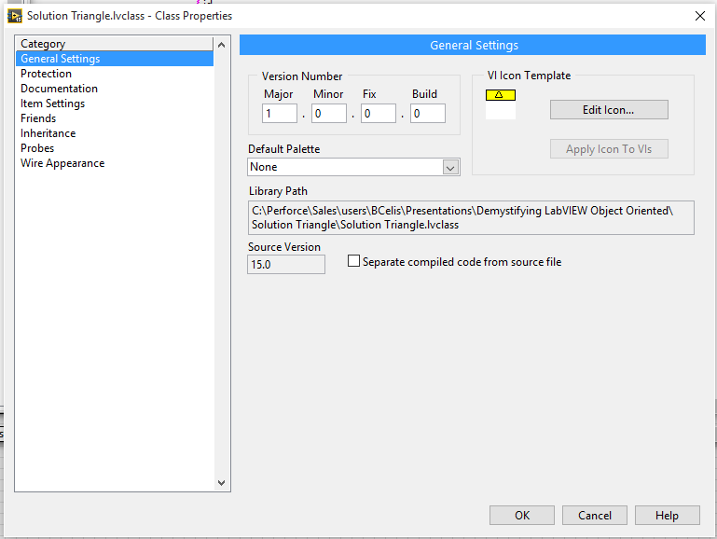
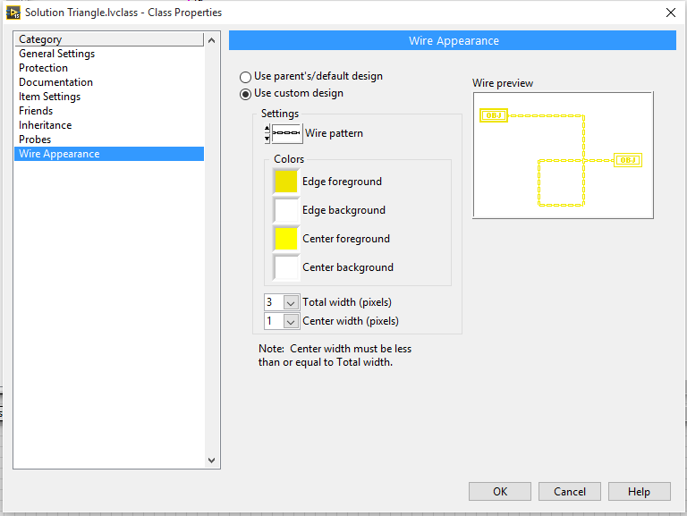
Edit Icon and Wire
Notes:
Updating the wire is optional. It is a good practice to do this with toplevel classes this allows to see upcast and downcast on the wires.

Slide 52
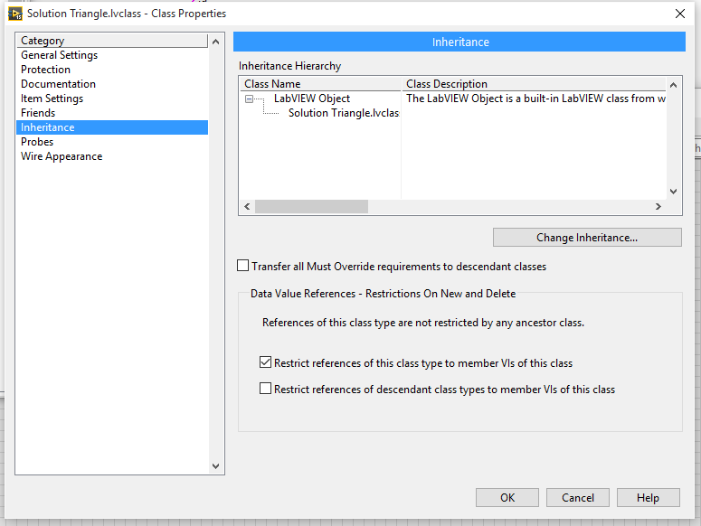
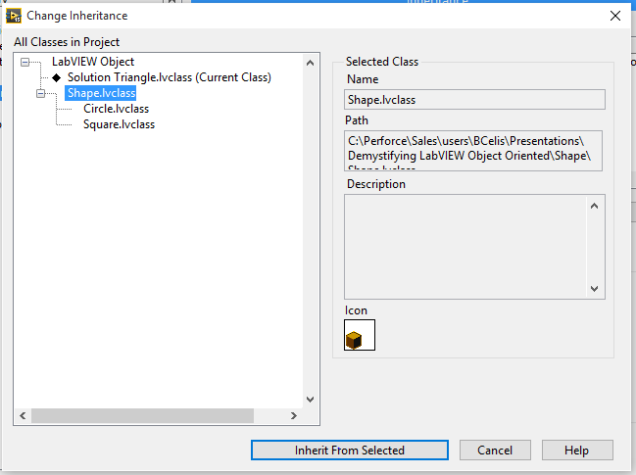
Change Inheritance
Notes:
In properties in the inheritance tab
Select Change Inheritance
The select to inherit from Shape.

Slide 53
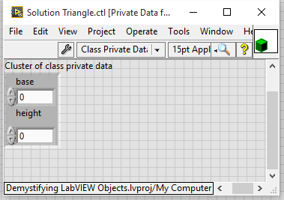
Edit the private Data
For the triangle we need the base and the Height

Slide 54
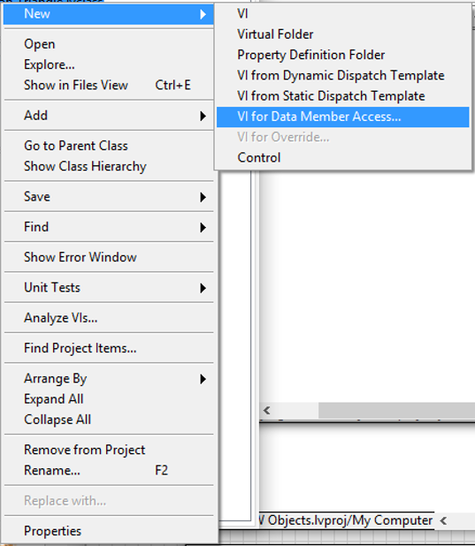
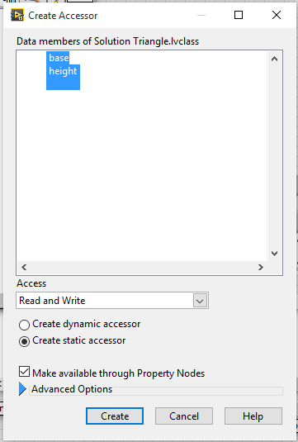
Create Access Methods
Notes:
In here we specify what properties we want. This allows us to auto generate the Vis to read and write to them
Also if we add the make available through property nodes allows us to use property nodes.
After created save the 4 new Vis

Slide 55
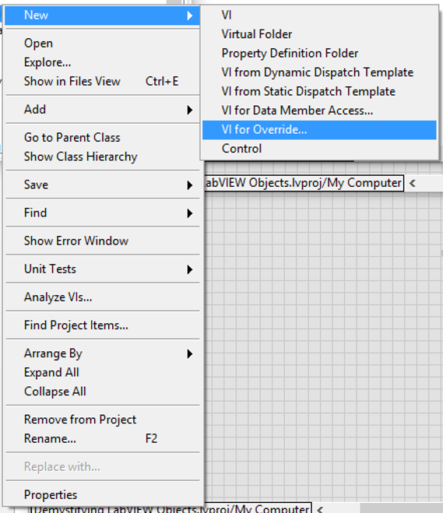
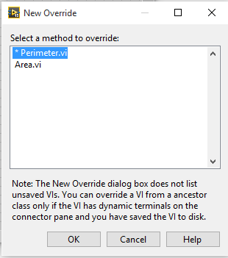
Create Methods for Override
Notes:
The ones with the * are required. The ones without it are not.
In this case we need to override both so select both of them and click OK

Slide 56
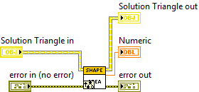

Area VI
Notes:
IN this case we don’t need anything from the parent method so we can delete the VI
The implementation should look like the one on the left
Its important to make sure the object is passed through and also the error.

Slide 57

Perimeter
Notes:
For simple math I am considering an equilateral triangle. So the base is the same length that the other sides.

Slide 58
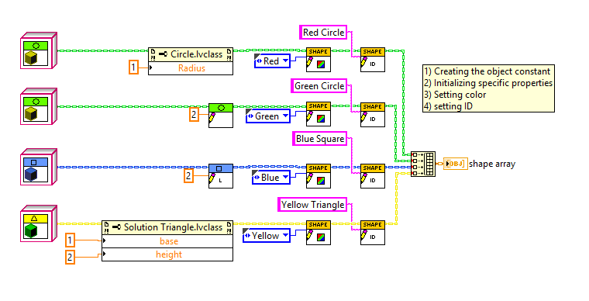
Add new class to the initialization

Slide 59
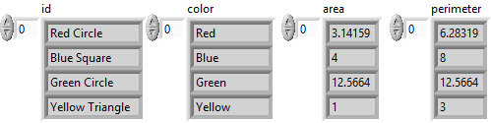
Run top Level VI

Slide 60
Demo Adding Channel
Notes:
I prefer this demo as its closer to what they will have to do also it is a real example.
To prepare for this demo you have to download CEF, you can find it in VI Package manager.
To prepare for this demo create a simple configurator editor

Slide 61
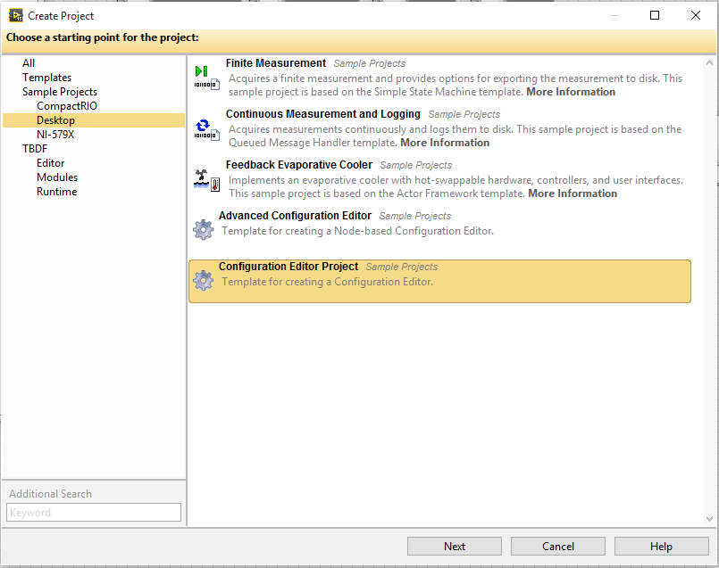
Creating new project from template
Notes:
New Project From Template
I recommend doing this before the presentation and have it already on disk/.

Slide 62
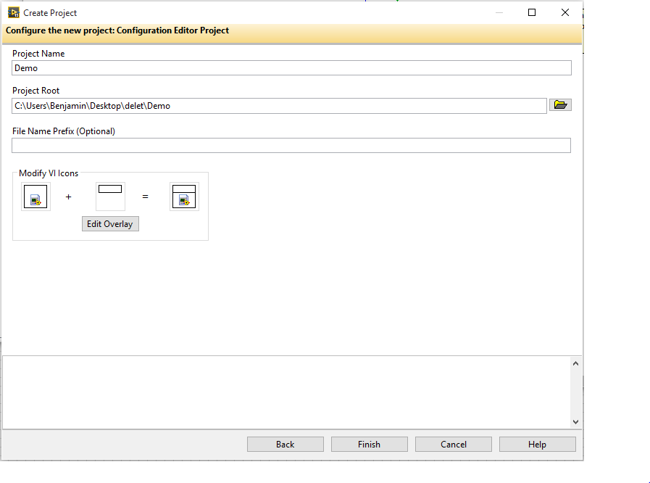
Notes:
After the project is created, run it and give a quick demo so they see the current functionality

Slide 63
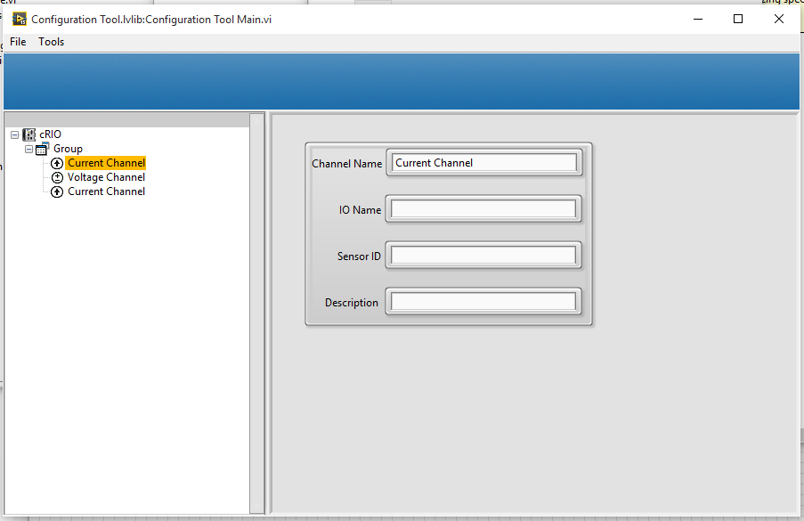
Running the configurator
Notes:
Run the Configuration Tool Main VI
Add some groups and some channels so the audience can see how it is working
Them mentioned we now want to have temperature channels too.
There are many changes we can do including changing the UI, but for this demo we are just changing the Channel name that get initialized and the ICON. Almost every behavior can be change by some override.

Slide 64
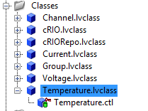
Creating a new Class
To Create a new class Right click on the My computer
New >> Class
This will generate a new class. Save it to disk to a new folder
Notes:
Its really important to use a new folder every time we generate a class.
Name spacing inside LabVIEW is handle by the library but at windows level, there can’t be 2 files with the same name in the same directory.

Slide 65
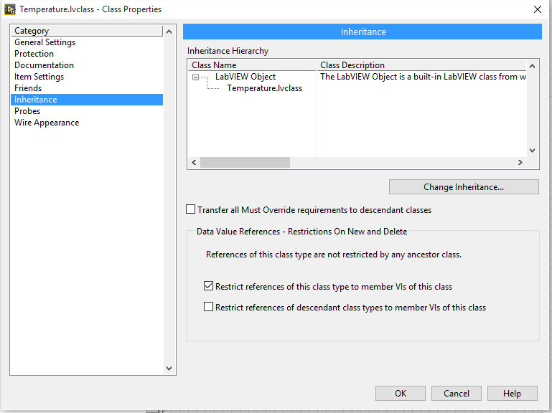
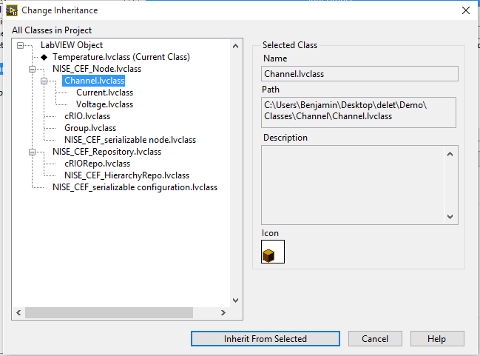
Change Inheritance
Notes:
In properties in the inheritance tab
Select Change Inheritance
Inherit from Channel
In this case we are not changing internal Data just the Icon and the name so we are modifying some properties

Slide 66
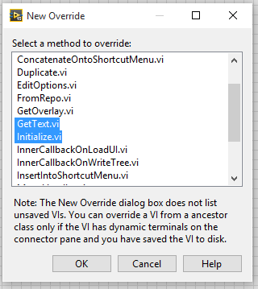
Create Methods for Override
Notes:
There are many Vis we can override for the purpose of this demo we only care about
What methods we need to override depends from the creators of the objects. If they have an * means you have to override.

Slide 67
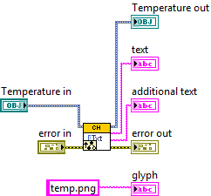
Changing the GetText.VI
Notes:
IN this case we are keeping the parent implementation we are just changing the glyph it will take.

Slide 68
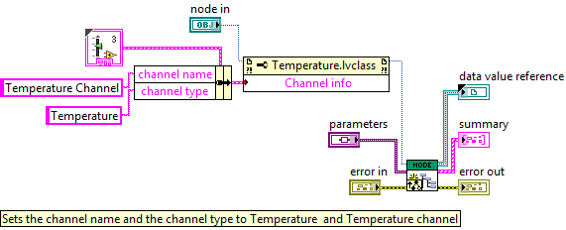
Changing the Initialize VI

Slide 69
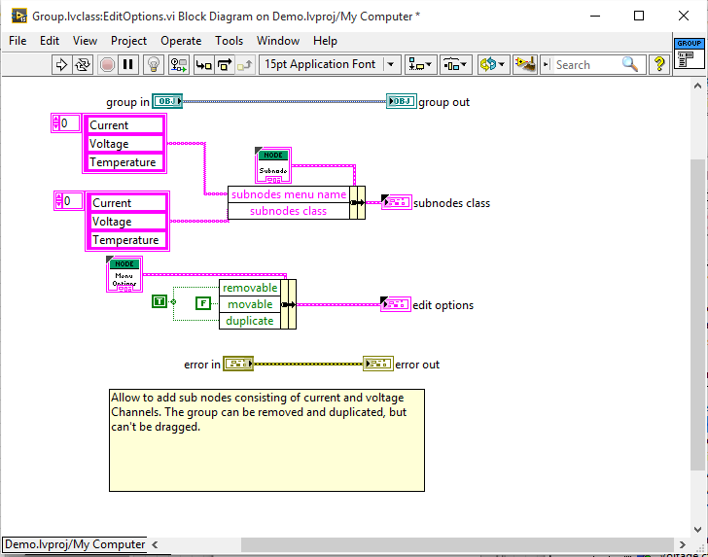
Change the group Edit Options VI
Notes:
The framework require the parent node to know which children to ADD.
Just Add Temperature to both arrays.

Slide 70
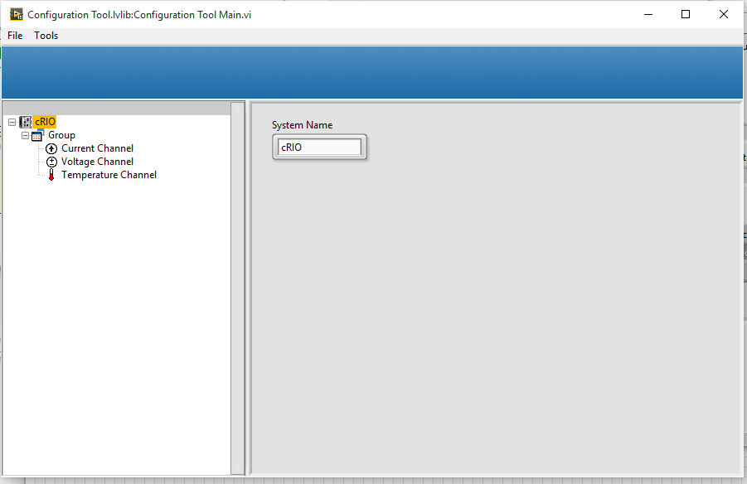
Running the configurator
Notes:
Run Again and show we now have temperature channels
Explain that we didn't change any on the top level VI, just added a new class.

